Slide 1
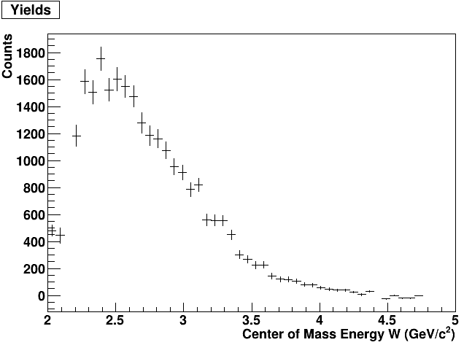
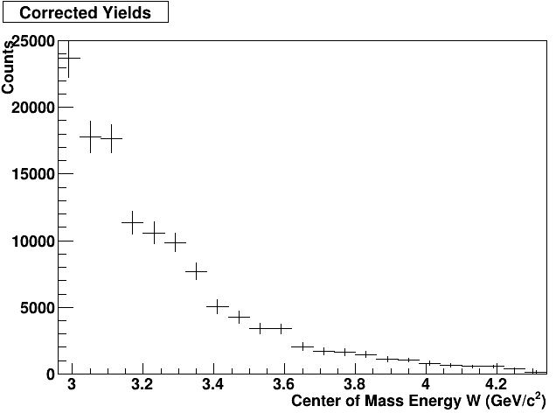
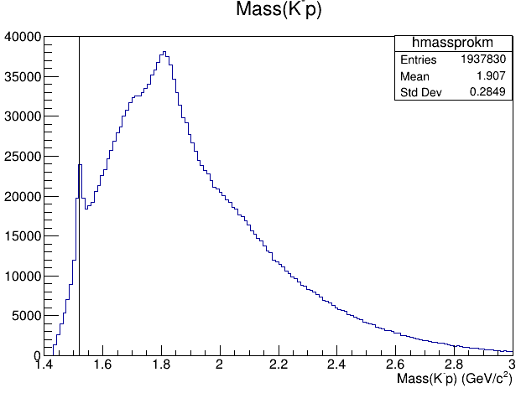
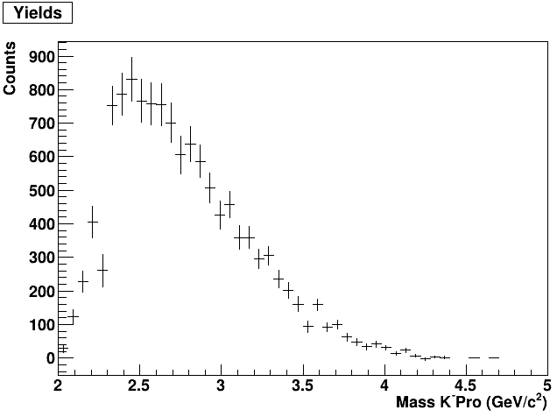
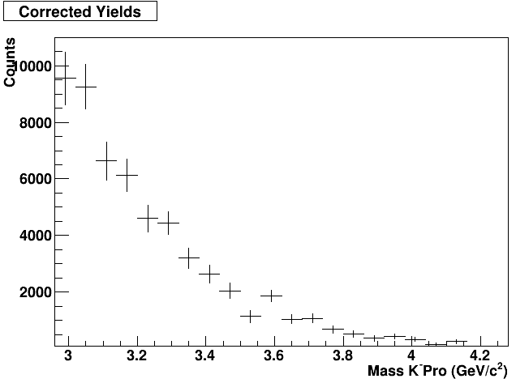
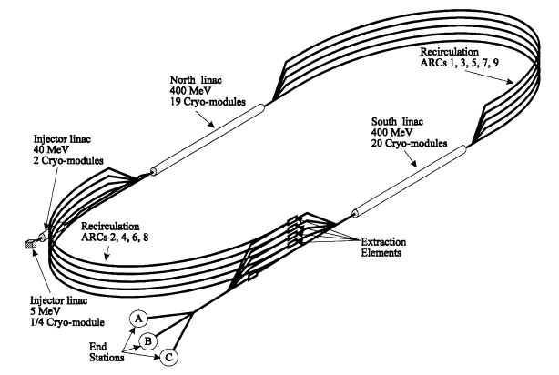
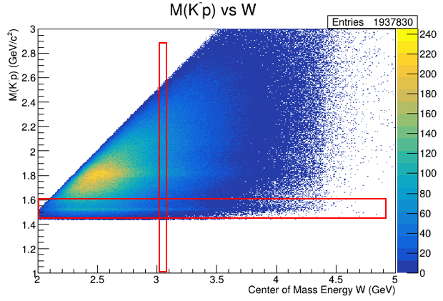
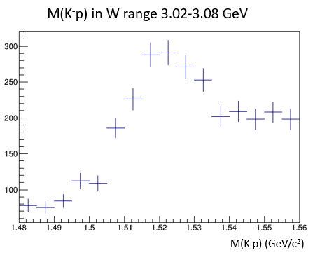
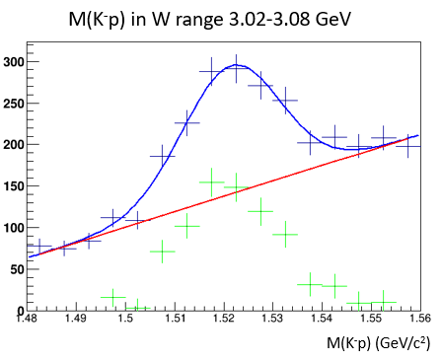
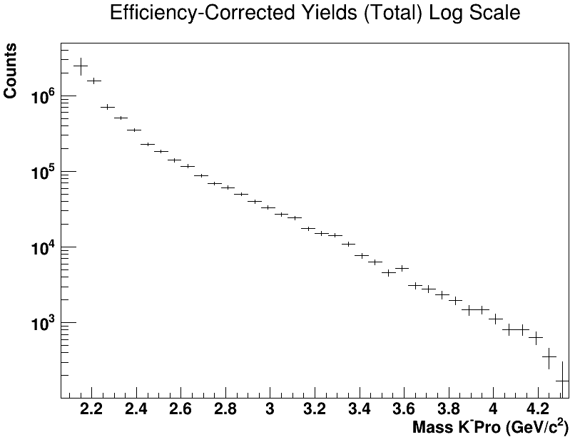
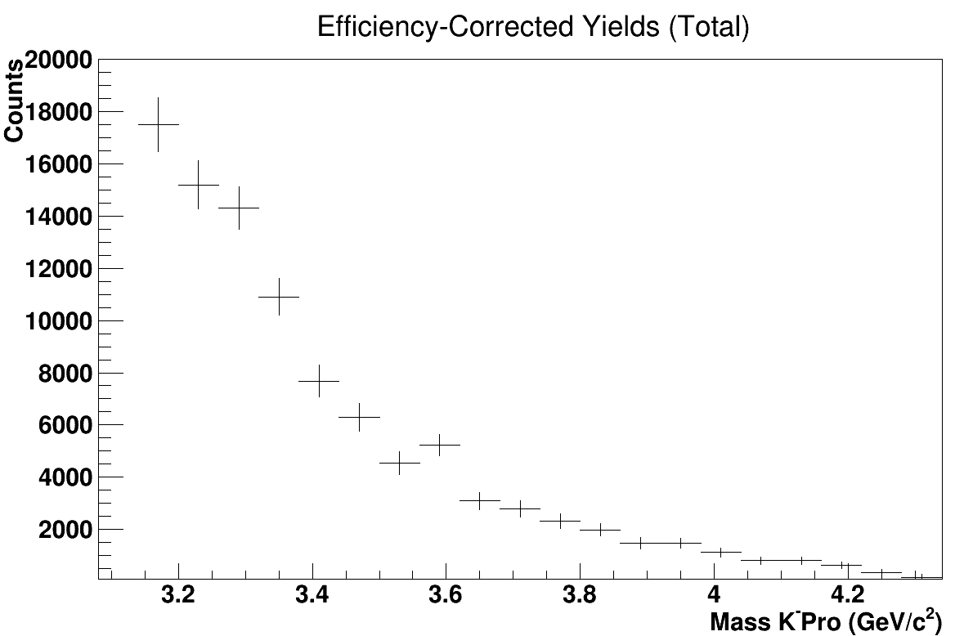
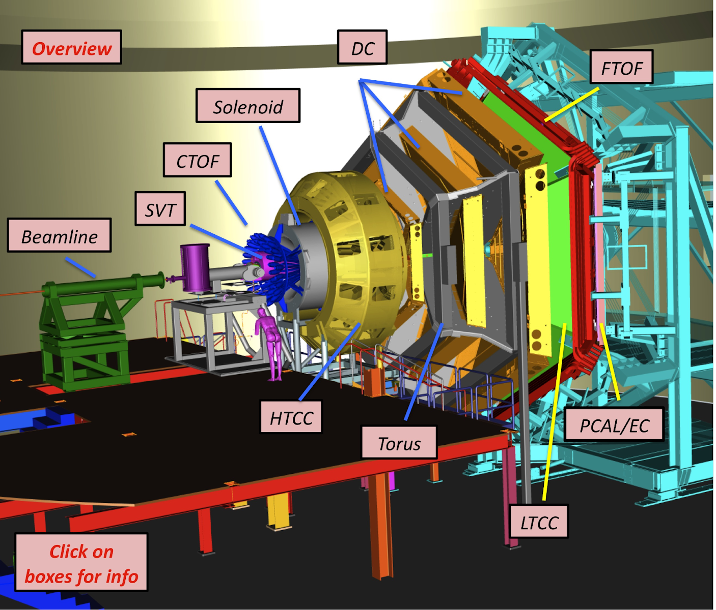
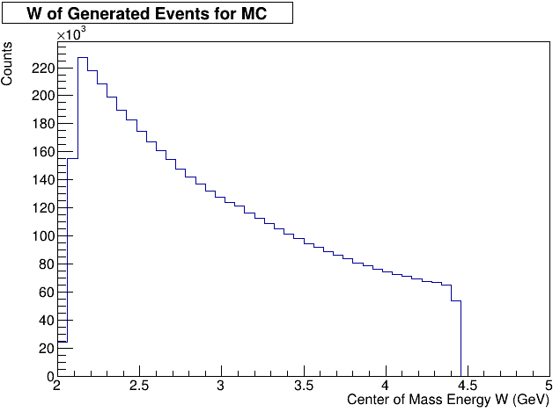
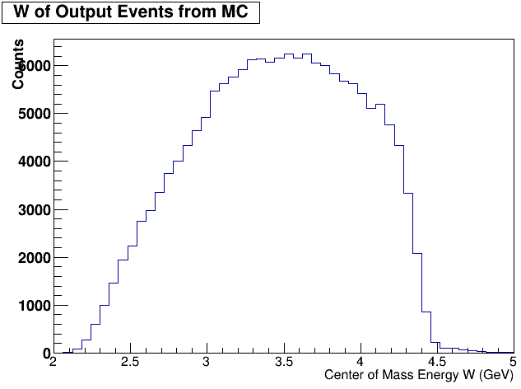
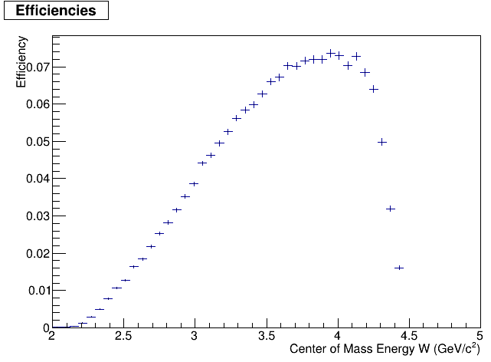
Cross Section Analysis for $ep→eΛ_{1520}K^{−}→eK^{+}K^{−}p$
Rebecca Osar, M. Dugger, B.G. Ritchie (for the CLAS collaboration) Arizona State University, Tempe AZ 85287-1504 *
Abstract: In nuclear particle physics, there is a discrepancy between theory and experiment concerning the numbers of existing nucleon resonances. Current models of nucleon resonances predict far more states than have been observed. To investigate this problem, $Λ_{1520}$baryons are reconstructed from a $K^{−}$ and a proton using the CLAS12 detector. From the reaction $ep→{eK}^{+}K^{−}p$with electron energies near 11 GeV, the invariant mass of the ${K^{+}Λ}_{1520}$system is used to determine yields, which are efficiency corrected to produce efficiency-corrected yields. In this presentation, efficiency-corrected yields of the reaction $ep→e{K^{+}Λ}_{1520}$in the center-of-mass energy of the virtual photon and target proton range $W=2$ - $5 GeV$ are shown.
Motivation
Analysis
Results
Reactions with excess energy can produce hadrons in excited states. These particles, being unstable, decay into lower-energy particle states. Reconstructing the mass distribution of excited hadrons reveals peaks, or resonances, the widths of which are inversely proportional to their lifetimes (shown in Figure 1).
Theoretical models predict more resonances than have been observed. Data from JLab’s CLAS12 detector show a prominent $Λ_{1520}$resonance, which is isolated to search for possible nucleon resonances decaying via the following channel:
An investigation into the yields of the $Λ_{1520}$ , corrected for detector efficiency, can shed light on the nature of the nucleon resonance spectrum for this reaction.
Event Selection
Events were selected based on particle requirements, detector requirements, and cuts. Events must have exactly one $e^{−}$ in the Forward Tagger, one $K^{+}$ and $K^{−}$ in the Forward Detector, and one $p$ in either the Forward or Central Detector. Cuts were placed three standard deviations out from the mean of the missing mass, missing energy, and missing transverse momentum.
Monte Carlo (MC)
An event generator was built to construct the desired reaction. Events are generated using relativistic kinematics and boosted reference frames, taking a virtual photon and a proton target, and assuming a nucleon resonance is created and then undergoes two two-body decays. The generated events are then pushed through Jlab’s Geant4 MC simulation framework (GEMC) and then reconstructed. Finally, the MC output is pushed through the same event selection code as the data in order to obtain the event acceptance.
Yields – Extracting Signal from Background
The 2D histogram in Figure 4 is used to obtain the yields of the data. A cut is made to keep events in the M(K⁻p) range from 1.48-1.56 GeV to isolate the $Λ_{1520}$. The x-axis (W) is cut into bins 0.6 GeV wide, and each bin is projected on the y-axis to plot the M(K⁻p) in the $Λ_{1520}$mass range for each energy range (Figure 5). Each bin is fit with a Gaussian plus a linear polynomial fit, where the linear fit is taken to be the background, and the Gaussian is taken to be the signal (Figure 6). The area under the Gaussian (with the linear fit subtracted) is summed to obtain the yields per energy bin. These are then plotted to look for resonances that decay into a ${K^{+}Λ}_{1520}$.
$ep→{eN}^{∗}$
$Λ_{1520}K^{+}$
$K^{−}p$
Figures 10, 11: Yields (left) and efficiency-corrected yields (right) of Spring 2019 negative data.
Figure 1: $Mass of K^{−}p$ (reconstructed $Λ^{∗}$and $Σ^{∗}$)
Peak at 1.52 GeV is $Λ_{1520}$ resonance.
Experimental Facility
Thomas Jefferson National Laboratory (JLab) consists of an electron accelerator attached to four different experimental halls, shown in Figure 2. Data for this experiment were taken from CLAS12, located in Hall B. Electrons of energy 11 GeV are fired at a proton. The data are from CLAS12’s RGA Spring 2019 negative inbending and Fall 2018 positive inbending. When combined, these datasets can provide a more comprehensive look into the resonance spectrum of the studied reaction.
CLAS12 Detector Elements
The central detector, located around the collision site, measures particles in the region 35° < θ < 125° and the full azimuthal range 0 < φ < 2π. It consists of a tracker and solenoid, a time-of-flight detector, and other detectors.
The forward detector, positioned 7 meters past the collision site, mostly measures particles in the region 5° < θ < 35° and the full azimuthal range 0 < φ < 2π. It contains drift chambers, a time-of-flight detector, a forward detector, an electromagnetic calorimeter (ECAL) with a Preshower calorimeter (PCAL) in front of it, among other detectors.
The forward tagger is used to detect electrons and photons in the narrow range 2.5° < θ < 4.5°. It is made up of a homogeneous calorimeter to identify electrons and measure electron energy; a tracker to measure scattering angles; and a scintillation counter to separate electrons and photons. In this experiment, electrons are required to hit the forward tagger to limit the virtual photon to a very low mass, close to that of a real photon.
Figures 12, 13: Yields (left) and efficiency-corrected yields (right) of Fall 2018 positive data. Note positive in-bending yields fewer events than negative, as expected in a net-positive reaction.
Figure 4: Mass of K⁻p vs W, with cuts on y axis from 1.48-1.56, divided into bins of 60 MeV along W. (spring data)
Figures 5 and 6: Mass of K⁻p in the range 3.02 < W < 3.08 GeV, without (left) and with (right) a Gaussian + linear fit. The blue fit is total, red fit is background, and green points are blue - red, taken to be signal. (spring data)
Figure 2: Sketch of the Continuous Electron Beam
Accelerator Facility (CEBAF)
Efficiencies
Detector efficiencies are obtained from the MC simulated events. Before being pushed through event selection, all input MC events are taken to be thrown events. The events that make it past the event selection are accepted events. Dividing accepted events by total events for each energy bin gives the efficiency distribution over W.
Figures 14, 15: Total Corrected Yields (spring and fall data combined), on a log y-axis (left), and standard axis, zoomed in to 3.1 < W < 4.3 GeV (right).
Conclusions
Efficiency-correction yields of $ep→eΛ_{1520}K^{−}$ have no obvious resonances. There are two small bumps at 3.3 and 3.6 GeV that require further investigation.
Next Steps
To obtain the cross section, the efficiency-corrected yields are normalized b$y σ=\frac{Y}{I_{in}N_{p}ɛ}$ , where $\frac{Y}{ɛ}$ are the efficiency-corrected yields, $I_{in}$is number of incident electrons, and $N_{p}$ is the number of target protons per unit area.
To improve resolution, more datasets from rga can be used.
Figure 3: Model of CLAS12 Detector
Figures 7, 8, 9: Thrown events (left), accepted events (middle), and efficiencies (right). (spring data)
*Work at Arizona State University is supported by award DE-SC0020404 from the Department of Energy.

